Slide 1

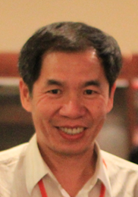
Algorithms for Biological Sequence Analysis
Kun-Mao Chao (趙坤茂)
National Taiwan University
http://www.csie.ntu.edu.tw/~kmchao/

Slide 2
About this course
Course: Algorithms for Biological Sequence Analysis
Fall semester, 2017
9:10 – 12:10 Tuesday, R107@CSIE Building
3 credits
Website: http://www.csie.ntu.edu.tw/~kmchao/seq17fall
Instructor: Kun-Mao Chao (趙坤茂)
Teaching assistant:
  Yi-Chen Huang (黃亦晨)

Slide 3
Coursework
Homework assignments and Class participation (10%)
Two midterm exams (70%; 35% each):
  Midterm #1: Oct. 31, 2017 (tentative)
  Midterm #2: Dec. 12, 2017 (tentative)
Oral presentation of selected papers/projects (20%)
Some basic knowledge on algorithms is required.
Background in bioinformatics and computational biology is welcome but not required for taking this course.

Slide 4
Topics
Part I: Sequence Homology
  Introduction to basic algorithmic strategies
  Pairwise sequence alignment
  Multiple sequence alignment
  Chaining algorithms for genomic sequence analysis
  Suboptimal alignment
  Comparative genomics
  Compressed / constrained sequence comparison
  Hidden Markov models (the Viterbi algorithm et al.)
Part II: Sequence Composition
  Sequence assembly
  Maximum-sum and maximum-density segments
  SNP and haplotype data analysis
  Approximate gapped palindrome
  Genome annotation
  Other advanced topics

Slide 5
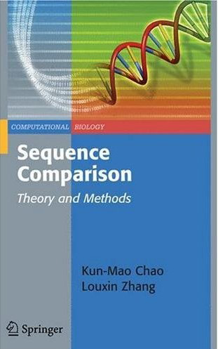
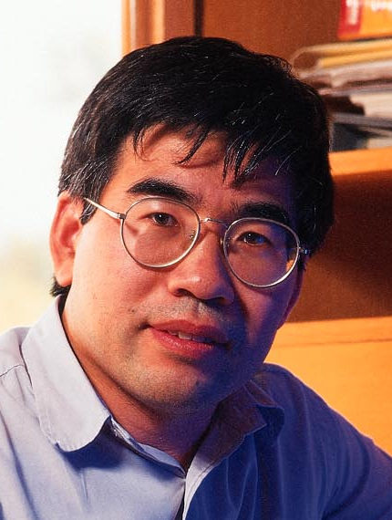
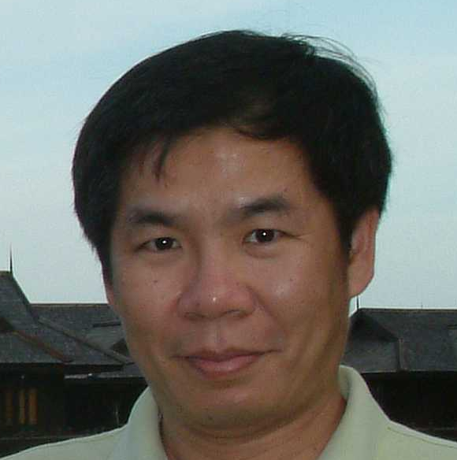
A Sequence Analysis Book
Published by Springer
Sequence Comparison: Theory and Methods
  by Kun-Mao Chao and Louxin Zhang

